Slide 1
Quality Services, Delivering What Matters
This session is being recorded

Slide 2
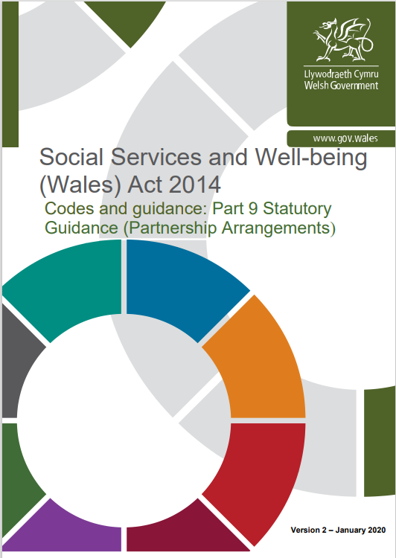
The background and policy framework: Quality Services
Alignment of Regional Commissioning : Requirements under the Social Services and Well-being (Wales) Act 2014
Requirement 72: Local Health Boards and local authorities should also, in relation to care homes:
Undertake a population needs assessment and market analysis to include the needs of self funders.
Agree an appropriate integrated regional market position statement and regional commissioning strategy. These will specify the outcomes required of care homes, including the range of services required. There should also be an agreement on the methods of commissioning (for example, some services may require a block contract, step up, step down intermediate care services, respite care, etc).
Agree a common contract and specification.
Agree common contract monitoring criteria and processes that include service user feedback.
Develop an integrated approach to agreeing fees with providers.
Develop an integrated approach to quality assurance.
Adopt a transparent use of resources. Budgets must be aligned with overall expenditure identified, together with the financial commitments of both agencies to the commissioning of care homes. These arrangements will need to be subject to a written agreement.
Requirement 85: Once there is agreement on what is required, partners should determine how best to accomplish the outcomes identified. This might mean changing the way services are delivered and designing new single models for delivery of services. It might also mean inclusion of:
Service improvement objectives e.g. effective mechanisms that can be implemented and evidenced in order to confirm links with other services, and which ensure that the needs of the individual service user are met during the transition between services;
Objectives to develop and improve quality and standards for service e.g. where relevant clinical and practice policies from the partner organisations could be harmonised. This might generate new process design for assessment and delivery of care;
Human resources objectives e.g. to address the need for team development and which support recruitment, retention, staff training etc.
Business objectives e.g. specific targets around activity, finance, identified risk or future change

Slide 3
Development of the processes
We already had a regional Escalating Concerns and Home Closures Procedures (2016), so why the change?
Previous approach
Concern raised
Decision made
Notice sent to provider that they are in formal concerns process
Commissioners’ providing additional support to services with quality and / or safety concerns in order to prevent (where possible) commissioners having to implement formal contract management procedures
Issues and/or concern raised
Proactive response inclusive with the provider
Actions agreed to address concern
Collaborative approach
New approach
Notes:
These new procedures replace the former Cardiff and Vale of Glamorgan Escalating Concerns and Home Closures Procedures (2016) and focus on proactively assuring quality services (for children, young people and adults) and preventing (where possible) the need for care and support services entering into formal concerns process.

Slide 4
The new approach
Gain advice from Safeguarding where there are concerns regarding the safety of individuals, where there is concern about the conduct of someone in a position of trust and where there is uncertainty about whether the matter should be the subject of a Safeguarding referral and further guidance is required.
Issue Raised
Safeguarding | Contracts | Complaints | Internal
Joint Quality Management Meeting (JQMM) or straight to Further Action if issue cannot wait to be considered at next JQMM
STEP ONE
FURTHER ACTION?
(Including same day monitoring if risk level requires this)
QUALITY ASSURANCE MEETING
Meet with provider and raise concern
NORMAL CONTRACT MONITORING
YES*
NO
ISSUES RESOLVED?
YES
NO*
Developmental Action Plan (DAP) /Corrective Action Plan (CAP)
*The steps 1-4 only serve as a guide. The process does not preclude the missing of steps where there is a clear rationale to do so.
CLOSE
(NORMAL CONTRACT MONITORING)
STEP TWO
STEP THREE
Provider Performance Meeting (PPM)
(PPM)
JOINT INTER-AGENCY MONITORING PANEL (JIMP)
Developmental Action Plan (DAP) /Corrective Action Plan (CAP)
Developmental Action Plan (DAP) /Corrective Action Plan (CAP)
Review Timescales
Review Timescales
DAP / CAP Performance Review
Every stage in the process will be informed by a standardised risk matrix
DAP / CAP Performance Review
IMPROVEMENT SATISFACTORY?
IMPROVEMENT SATISFACTORY?
YES
NO*
STEP FOUR
YES
NO*
SERVICE OPERATIONS SUPPORT GROUP (SOSG)
Notes:
The “NEW” Regional Escalating Concerns Process– some of the meeting names may be familiar, but to bring consistency across the region they might now be at different levels of escalation

Slide 5
Next steps
Iterative development
V 1 of Quality Services Delivering What Matters
Revisions when necessary
Ongoing learning
Drafting
Sign off by Cardiff Council. Vale of Glamorgan Council, The Local Health Board
Instruction to Regional Commissioning Board to publish and maintain version control
Improving quality
Use of V 1 of Quality Services Delivering What Matters
Statutory Partners updating lessons learned logs
Regional Commissioning Board monitor ongoing learning and when required escalate a trigger with the statutory partners to review and update the policy
Notes:
This policy is a regional approach which will evolve, assessing lessons learned following each use, seeking better ways to provide support to services with quality and / or safety concerns in order to prevent formal contract management procedures.

