Slide 1


The Power of Co-Production Sharing real life experiences of co-production and its impact on service delivery
RPB Conference
16th May 2025

Slide 2
An Introduction to the Workshop Duncan Innes Cardiff Health and Social Care Facilitator C3SC

Slide 3
Supporting Older Adults with Mental Health across Cardiff and the Vale of Glamorgan Joanne Wilson Directorate Manager: Mental Health Services for Older People Cardiff and Vale UHB

Slide 4
Supporting Older Adults with Mental Health across Cardiff and the Vale of Glamorgan

Slide 5
EmpowerMind Events: March 19th 2024
Improved Access to Diagnosis and Support: Reduce wait times, enhance access to crisis support, and provide clearer information | Enhanced Communication and Respect: Improve communication between services and provide training for professionals on empathy and respectful communication. Clearer Information: Deliver information in plain language and ensure it is readily available
Enhanced In-Patient Care: Implement better safety measures, ensure consistent care plans, and improve communication with families. | More Accessible Support Groups: Make support groups easier to find and available during evenings and weekends
Increased Support for Carers: Provide respite care, support groups, clear information, and follow-up for carers | 24/7 Crisis Drop-In Centre: Establish a centre that is always open for crisis support.
Integrated Services: Ensure services work together seamlessly. | Individualised Care Plans: Develop care plans tailored to each individual’s needs
Peer Support: Increase opportunities for peer support | Focus on Carer Well-Being: Prioritise the well-being of carers

Slide 6
EmpowerMind Events: March 19th 2025
Communication Challenges: Information overload and lack of clarity on services. Poor communication with carers and families. Staff empathy and active listening vary significantly. Repetitive referrals strain both staff and patients. | Workforce Issues: Understaffing, workforce pressures, and reliance on agency staff. Staff undervalued and under-rewarded, leading to turnover and burnout. High reliance on outdated systems and lack of multi-agency coordination
Care Accessibility and Coordination: Difficulty navigating referrals, eligibility, and access to services. Lack of follow-up after diagnosis or discharge. Insufficient coordination between services and shared information systems. | Cultural and Individual Needs: Limited consideration for cultural diversity and language barriers. Lack of person-centred approaches; patients feel like part of a process. Snap judgments and gatekeeping pre-diagnosis hinder trust.
Support for Carers: Carers feel overlooked and unsupported, impacting their confidence. Preventative and wellbeing-focused measures are insufficient. Courage and effort required to seek support often go unrecognised. | Innovation and Training: Interest in leveraging AI and technology to reduce workloads. Importance of tailored training programs (e.g., specific diagnoses, empathy-building). Use of arts and storytelling for staff development.

Slide 7
What has been done?
MHSOP Community Review
111P2
Shared Care Record
Liaison meetings between MAS and MHSOP
Liaison meetings between GPs and MHSOP
Recruitment for two Peer vacancies (SOLACE and Psychosis)
Monitoring of inpatient discharge follow up

Slide 8
Joint Operational Group
Use the outcomes from the EmpowerMind events to shape our priorities
Widen the group to include more people with lived experience as a service user or carer
Work with Caniad and other partners to advertise the group
Take quick action where we can, and where its appropriate
Use the network to share best practice, knowledge and information. Encourage co-working opportunities

Slide 9
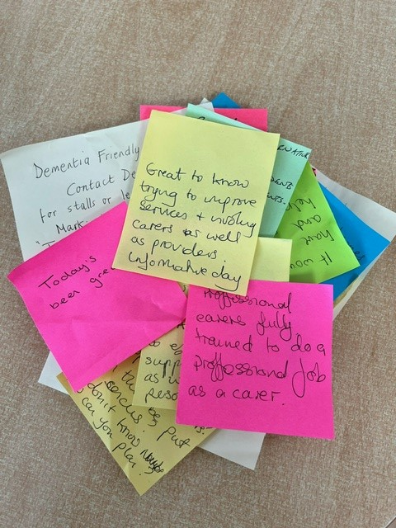
What Next…
Link in with the 5 workstream pillars of the All-Wales Dementia Pathways of Standards
Community Engagement
MAS
Dementia Connector
Hospital Charter
Workforce Development and Measurement
Identify key T&F themes
Plan for next EmpowerMind

Slide 10
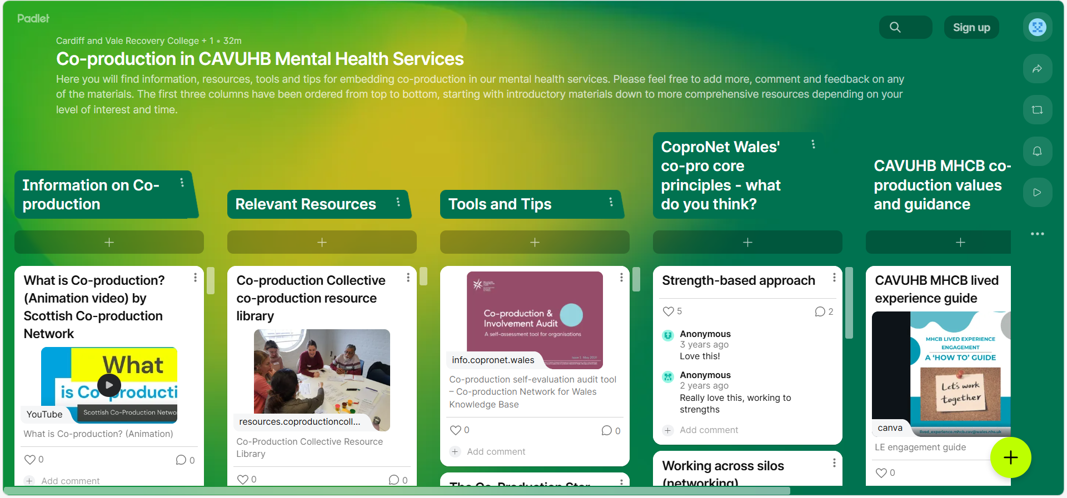
Co-production Padlet in CAVUHB Mental Health Services

Slide 11
Contact Us…
Victoria.Hartley-Smith@wales.nhs.uk
Joanne.Wilson3@wales.nhs.uk
02921 825777 or 02921 825776
Alexandra.Congreve@wales.nhs.uk

Slide 12
Co-designing RSPB Nature Prescriptions in Cardiff to support and improve wellbeing and health David Llewellyn Nature and Wellbeing Lead – RSPB Cymru

Slide 13




Co-designing RSPB Nature Prescriptions in Cardiff to support and improve wellbeing and health
David Llewellyn Nature and Wellbeing Lead – RSPB Cymru Cardiff Regional Partnership Board- 16 May 2025
Funds raised by players of People’s Postcode Lottery
CYMRU
Notes:
Thanks for the opportunity to present to you today – much appreciated.

Slide 14

What are RSPB Nature Prescriptions?
Support healthcare professionals to deliver – not a referral into activities or another service
Focus on nature connection in people’s immediate locality – nature is not simply a backdrop
People are encouraged to notice nature wherever they are, addressing some of the identified health inequalities and barriers to nature​
Reciprocal relationship between the wellbeing of people and nature

Slide 15

What are RSPB Nature Prescriptions?
a guided conversation between a trusted professional and their client to encourage and support them to connect with the natural world to benefit their mental and physical wellbeing​
supported by a co-designed booklet of seasonal ideas and suggestions to enable people to explore ways of connecting to nature that are personal and meaningful to them
free to the recipient, non-medical approach based on accessible, self-led activities that people can do from anywhere with no need to travel, on their own or with others​

Slide 16

PHASE 1 October 2024 - January 2025 Preparation: listening and talking to and learning from potential partners (develop trust and relationships)
PHASE 2 February 2025 - May 2025 Co-design sessions: 3 online and 2 in person (oversubscribed) Offline input: Padlet and emails as well as meetings and discussions
PHASE 3 May 2025 Revisit and allow time for feedback - seek contributions
Delivery support and training sessions (learn from these)
Run in parallel with Newport
– allowed cross-fertilisation of ideas

Slide 17

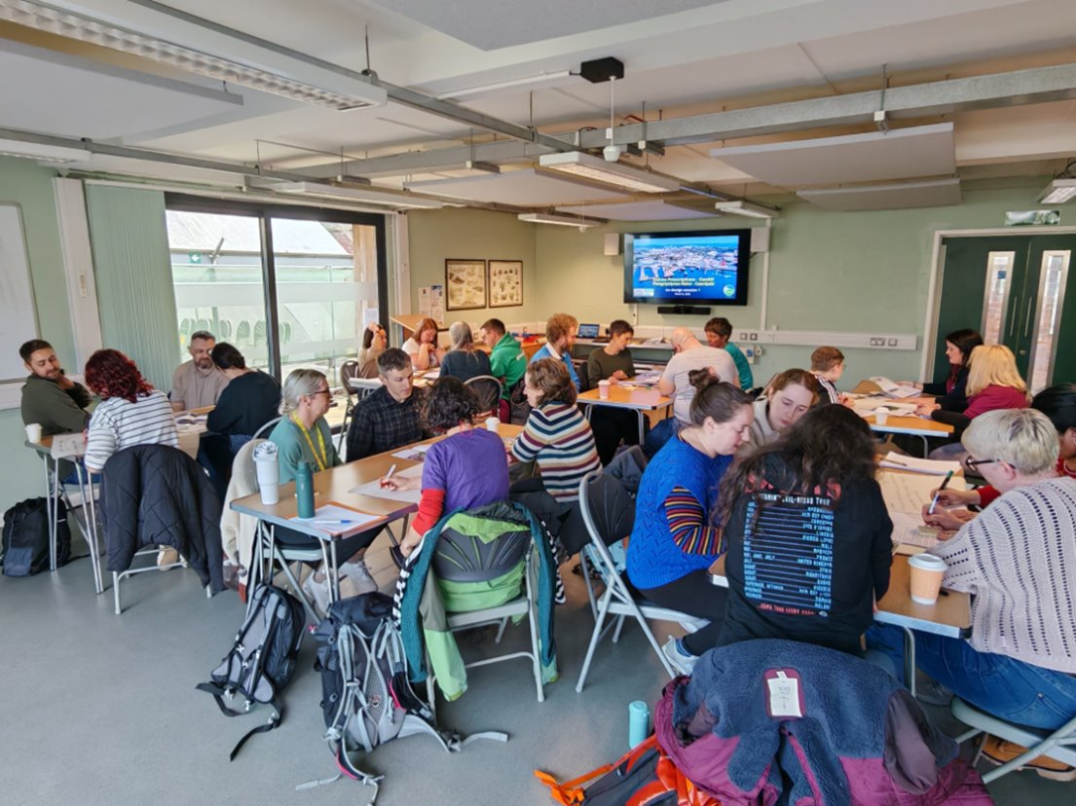
Co-production versus co-design Set out honestly and clearly what is available for change/additional input

Slide 18

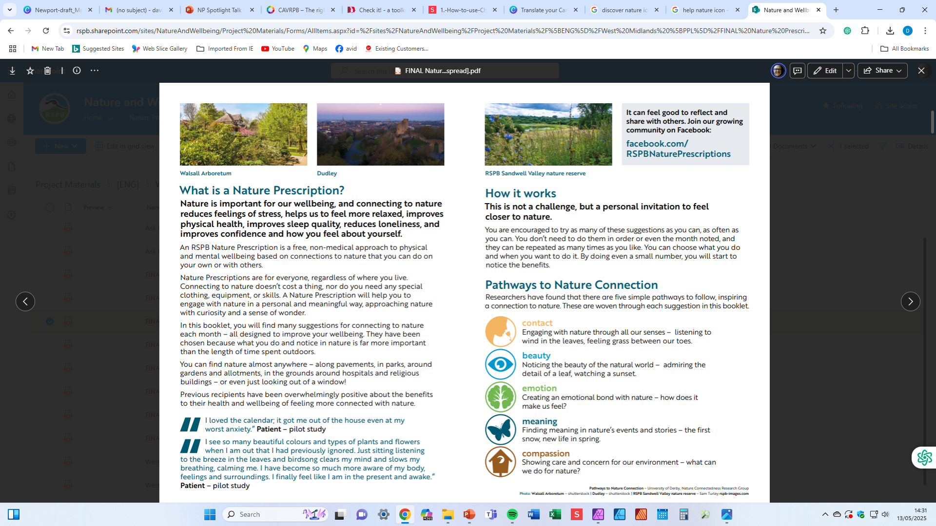
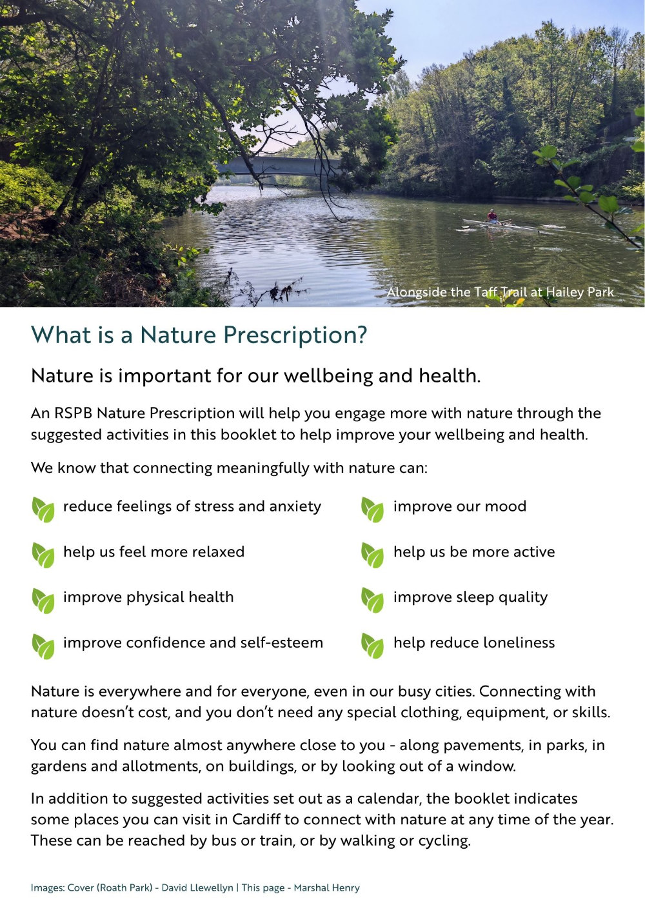
Be prepared to actually take on suggestions and ideas with honesty and challenge

Slide 19
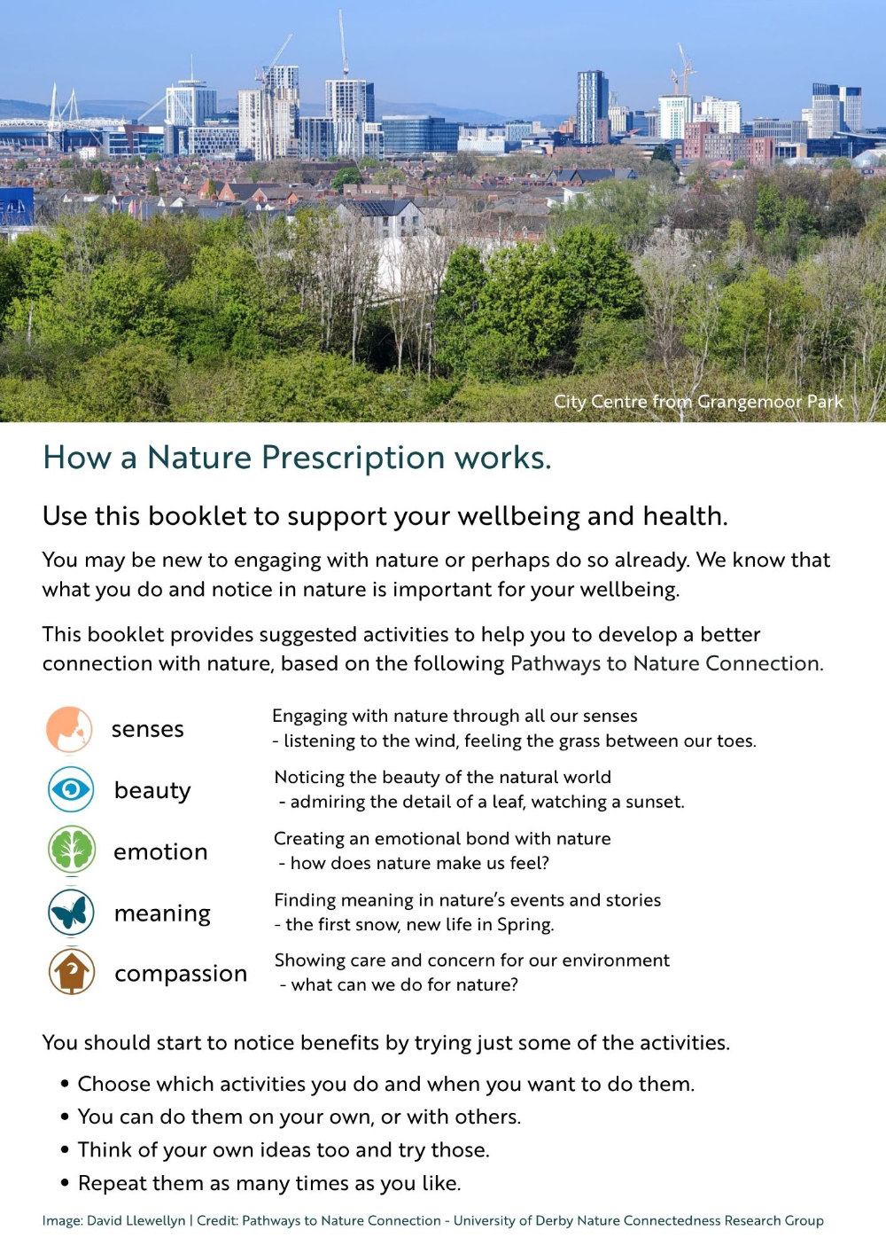

Slide 20
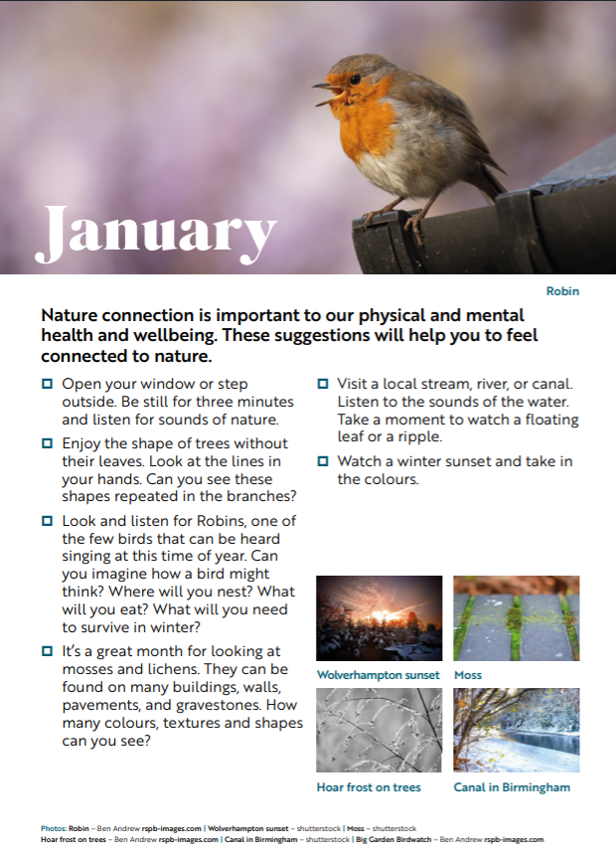
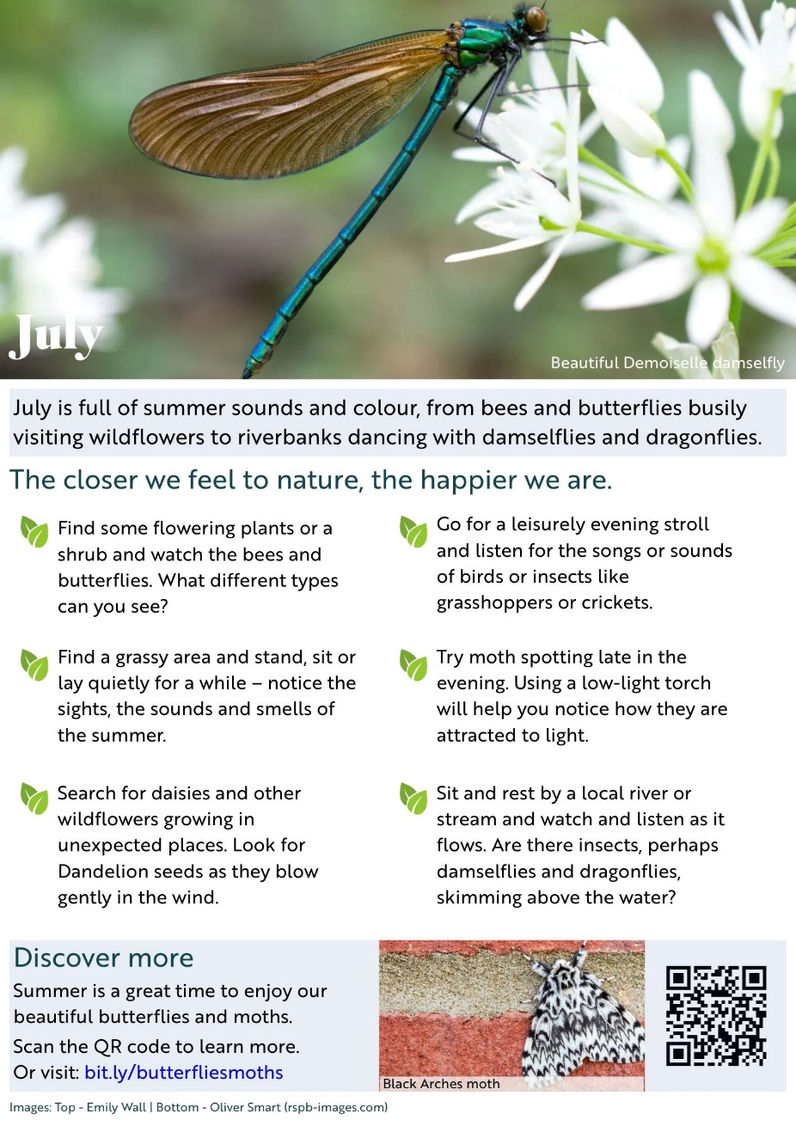

Encourage input and joint ownership at all levels where possible

Slide 21
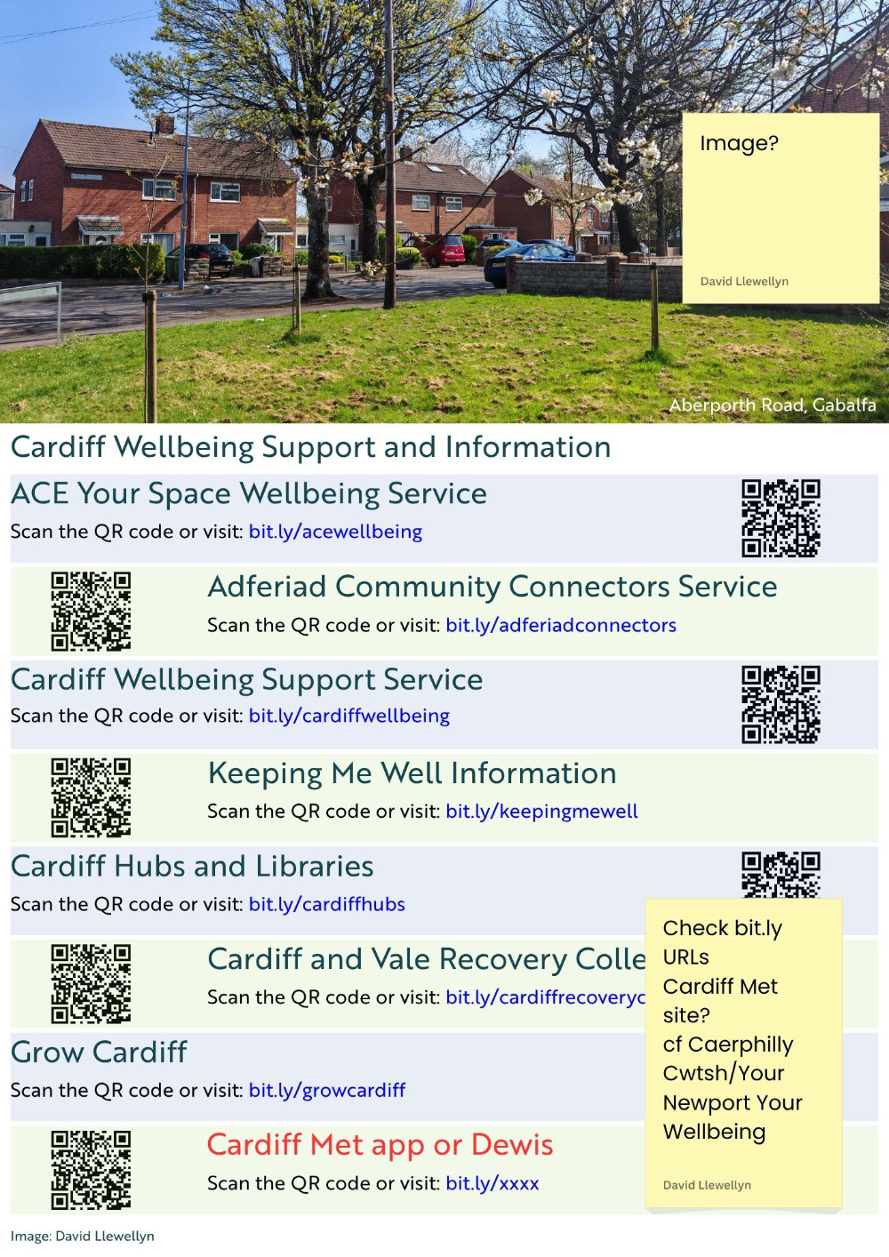
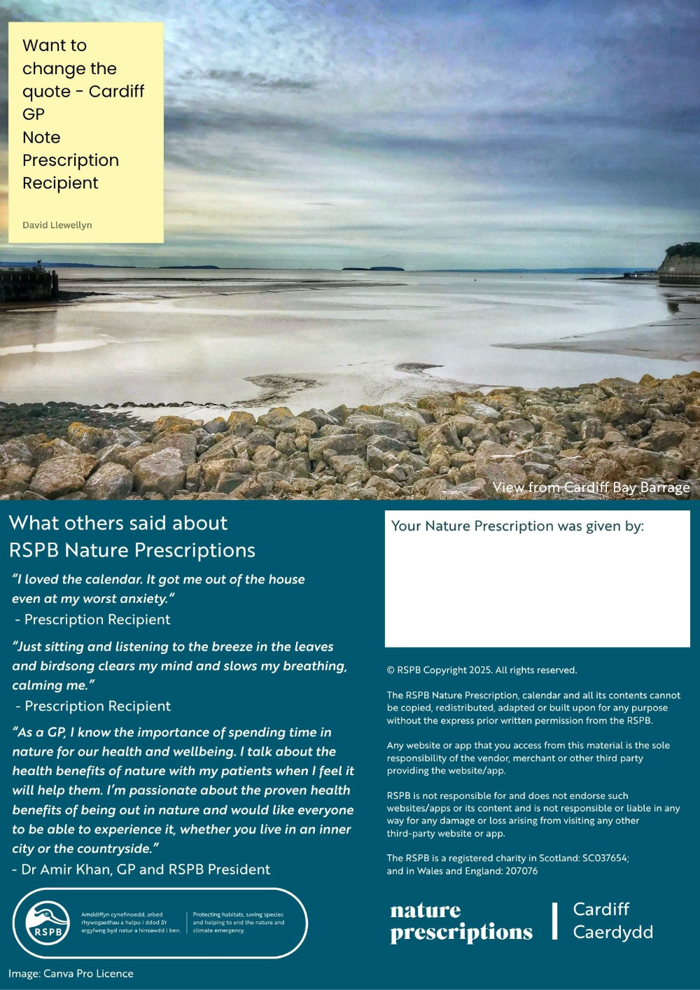

Slide 22
Thank you/Diolch yn fawr
david.llewellyn@rspb.org.uk
Funds raised by players of People’s Postcode Lottery
CYMRU

Slide 23
Lisa French: Participation Manager, Innovate Trust Joanna Jones: Healthcare Support Worker, Cardiff and Vale RPB Stacey Traylor: Healthcare Support Worker, Cardiff and Vale RPB Meaningfully Engaging People with Lived Experience in Co-Production

Slide 24
Group discussions Exploring the questions: What are the identifiers of successful Co-Production? What are the barriers to successful Co-Production?

Slide 25
Sharing Findings: A full group discussion, identifying common themes, and co-create solutions to overcome the barriers identified. This collaborative conversation will provide practical takeaways to support co-production beyond the workshop.

