Slide 1
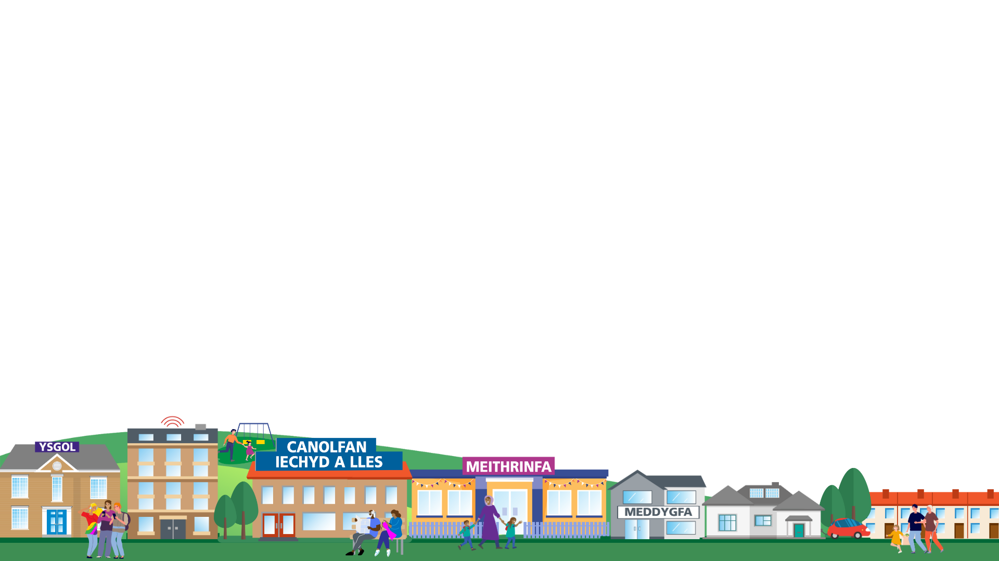

Thinking Differently
Considering Alternative Approaches to Traditional Care Models for Neurodivergence
RPB Conference
16th May 2025

Slide 2


An Introduction to the Workshop
Dan Crossland
Director of Operations
Mental Health Clinical Board
Cardiff and Vale University Health Board

Slide 3
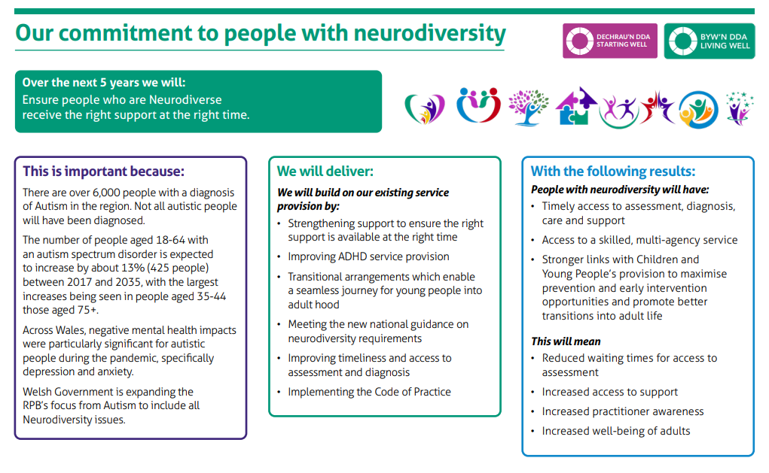
Joint Area Plan 2023-2028

Slide 4

Supporting Families
Karen Mills
AP Cymru
Founder & Director

Slide 5
Adult ADHD Services
Leanne Freeman
ADHD Lead Practitioner Cardiff & Vale UHB

Slide 6
Current situation
Service Delivery: Currently managed by Community Mental Health Teams (CMHTs)
Rising Demand: Referral numbers continue to grow
Capacity Crisis :Waiting lists exceed 4yrs
Key Challenges :
  Staffing
  Financial constraints
  Demand significantly outweighs available resources

Slide 7
Aim of Adult ADHD Service
Change the narrative
Rethink our approach –managing expectations
Promote neurodivergent inclusivity – through support, peer networks, education, and deeper understanding
Question the role of diagnosis – Are we over-medicalising ADHD?

Slide 8
Key Considerations for Rethinking ADHD Support
Shift the Mindset: ADHD is a lifelong neurodevelopmental condition, not just a childhood issue
Diagnosis Trends: Currently, only moderate to severe cases are typically diagnosed
Diagnosis Always Necessary?: Consider the role of support versus formal medicalisation
Medication Limitations: What happens when medication isn’t suitable or effective?
The Value of an MDT Approach: multi-disciplinary collaboration is a MUST for holistic care
Lifelong Tools
Peer support / group work: Shared experiences through group work and community
Coaching: Practical strategies to manage daily life and build executive functioning
Medication –NICE Guideline recommends medication alongside therapeutic support

Slide 9
Proposed Pathway
Initial access- patient joins ADHD support group (F2F or online option)
Further signposting to resources and services as needed
Review period – completion of course , if no significant improvement seen within 3mths
GP refers patient to specialist ADHD Service

Slide 10
We’ve explored a new pathway for ADHD support grounded in inclusivity, early intervention, and multidisciplinary care.
How could this proposed pathway work in our setting?
What are the potential barriers or enablers?
What are your thoughts, ideas, or concerns?

Slide 11
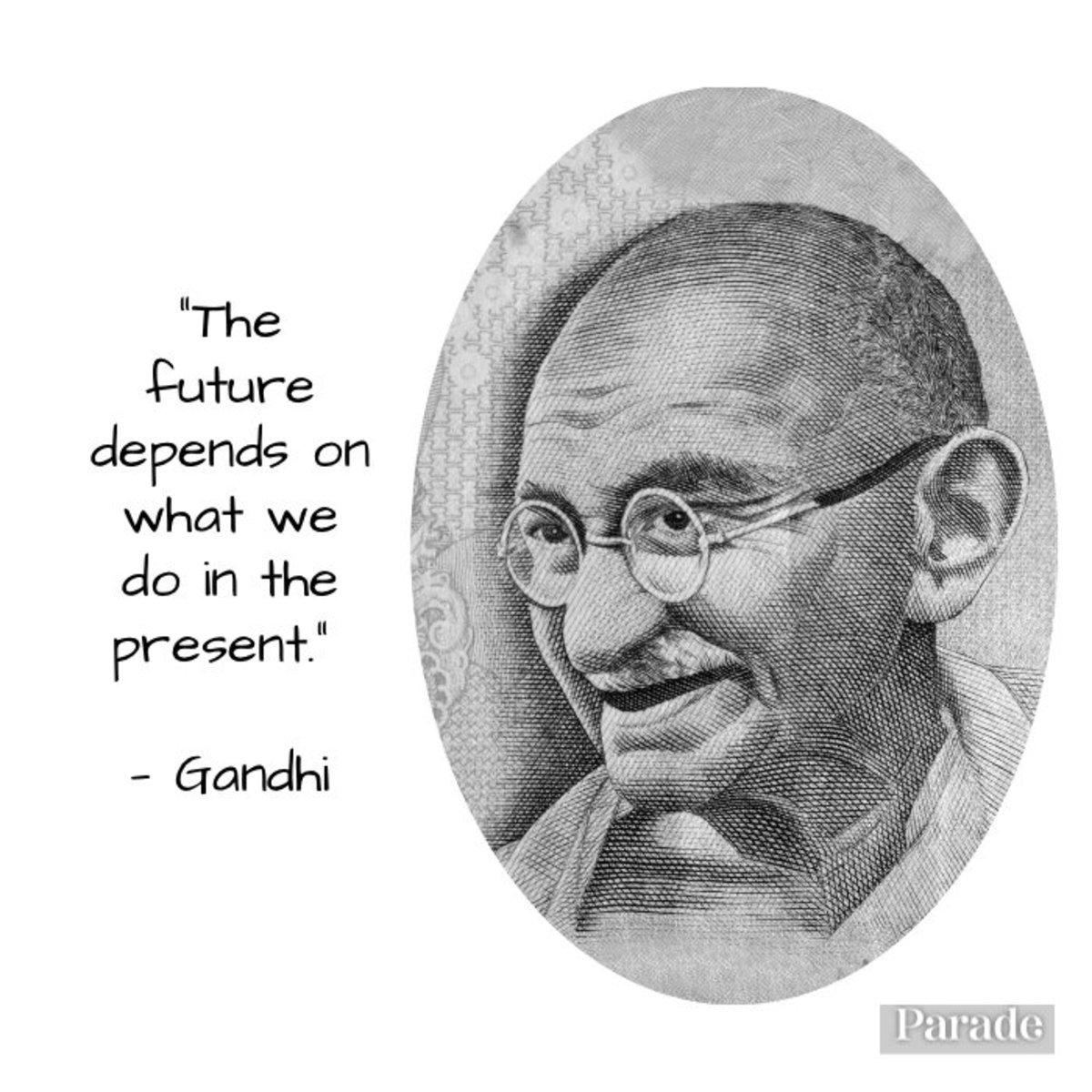

Slide 12
Thank you
Leanne Freeman
ADHD Lead Practitioner / RGN / Trainee Advanced Clinical Practitioner
Leanne.Freeman@wales.nhs.uk

Slide 13


Thinking Differently
Neurodevelopmental Service
Rosanna Catinella (Service lead) and Lisa Coombs (SPOA clinical lead).
“Inclusion starts with understanding.
Access begins with listening.”

Slide 14


Current Landscape
Long waiting lists
Too often, the system asks neurodivergent people to adapt to it, rather than the other way around.
Key message: Access should be proactive, not reactive. We need a shift in mindset.

Slide 15
What does thinking differently mean for us?
It's about how we move from awareness to action, in how we view, build and deliver services
Thinking differently means?
Asking “what works for you?” Rather than, “how do we fix you?”
Making the accessibility the starting point
Key message: Lived experiences is not optional –it's essential

Slide 16

Our Service Aim
To co-create flexible, empowering, and inclusive services with neurodivergent people-from design to delivery.
This means:
Training all staff in neuro-affirming practice, not just awareness
“When redesigning our pre-triage appointments for home-schooled children, we started with a simple question: What do our families actually need?
We listened to parents, carers, and neurodivergent young people directly-shaping the service around their experience, not assumptions

Slide 17
Lived Experience
Permission granted 12/05/2025
From as young as the age of 4, I remember struggling to respond and communicate to questions within social settings. This would include me not answering my name for the register at school and rely on my peers to answer for me. As far back as I remember I was reluctant to share opinions as I was desperate to fit in, so I would just mimic other people's opinions, even though I thought differently (Masking).​
Over the years this affected my mental health, especially in adolescence as I was holding back my true self. I didn’t feel I then, had learnt the skills to navigate myself socially with new topics. This particularly affected me when I became interested in new relationships, and I struggled to communicate as my peers developed and outgrew me, in this and I was left behind. ​
The gap was noticeable much more at age 14, and I presented differently to my peers, as I was not doing what they would expect of me. This led me to experience poor mental health such as anxiety and severe depression. This was all in the name of feeling different and not receiving the correct support to harness my strengths.​
However, with the correct understanding and educational support I later went on to achieve academically. Although I still struggle with anxiety, It never totally left me due to the challenging new situations. I must learn to navigate every day; I now accept this. I learnt people accept me for who I am. My advice would be to keep pushing yourself out of your comfort zone and embrace the uncomfortableness as being part of you.

Slide 18

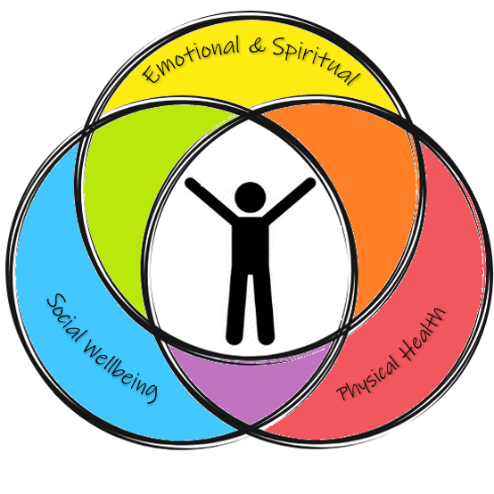
Action in motion
Listening without judgement
Building with, not for
Thinking beyond the lens of reasonable adjustments
Let's move from awareness to action
A diagnosis can validate a person's lived experience, but it's not the solution itself
Final Takeaway Message:
We all think differently. So, our services must too. Neurodiversity is everybody's business.

Slide 19

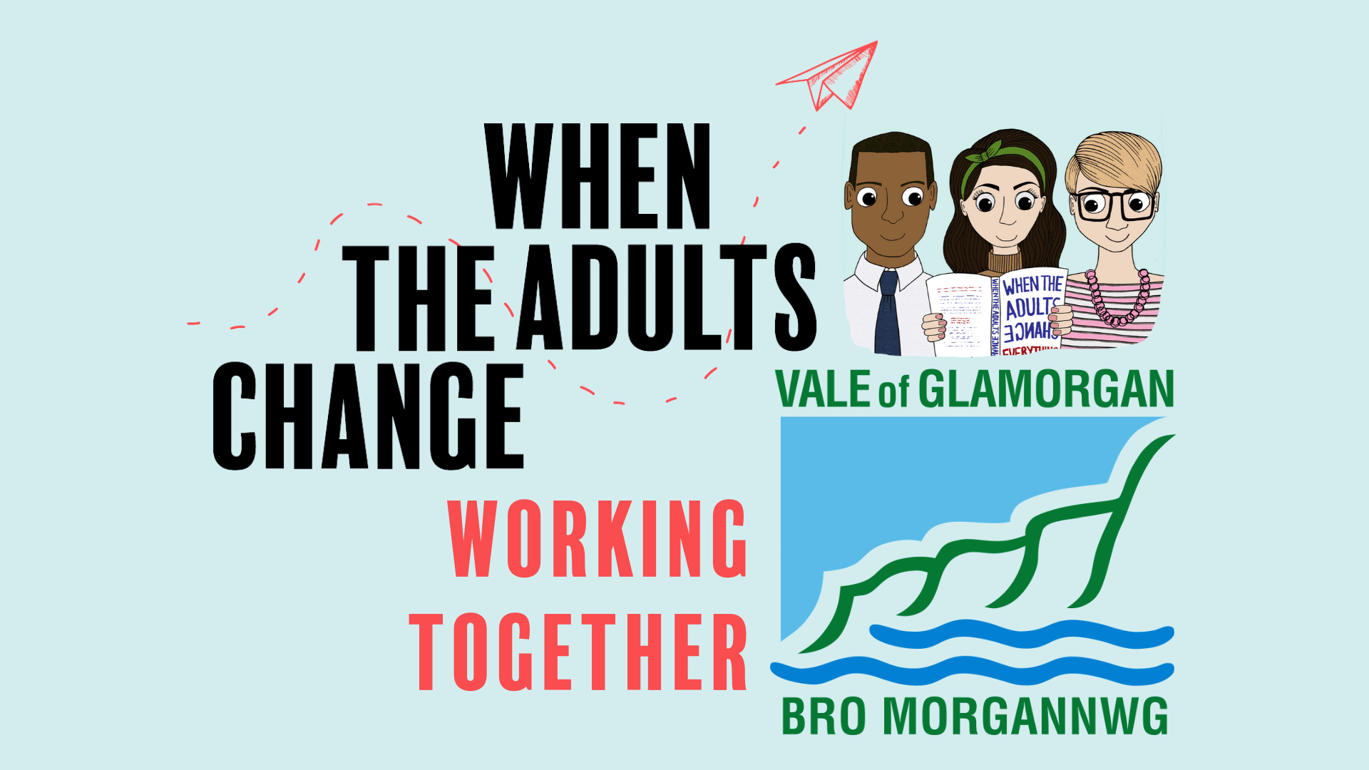
Right Support, Right Time
Neurodivergence in Education
Emma Carver
Deputy Headteacher, Ysgol Y Deri
Engagement Service Team Lead

Slide 20
Discussion so far – Q&A
Anna Tee
Partnership Programme Manager
Cardiff and Vale Regional Partnership Board

Slide 21
Group Discussion
Consider the following questions:
What is the one thing we could do now that would make a real difference for individuals?
How do we work together differently to create the ideal ND pathway?
Do we have a question to put to the Executive Panel Q&A?

Slide 22

Summarising Conclusions & Outcomes
Dan Crossland
Director of Operations
Mental Health Clinical Board
Cardiff and Vale University Health Board

