Slide 1


Cardiff and Vale Regional Partnership Board Conference 16th May 2025
Horizon Scanning
Integrated Community Care System
Rhian Matthews – Professional Advisor, Frailty and Integration, Welsh Government
Cath Doman – Director of Health and Social Care Integration, CVRPB
Geraldine Johnston – Director of Operations, Primary, Community and Intermediate Care Services, CVUHB

Slide 2

Workshop agenda Council Chamber
1 | Introductions
2 | What is an ICCS and why bother? WG direction and ambition
3 | What problem are we trying to solve?
4 | Carmarthenshire case study
5 | What’s the approach in C&V: phase 1
6 | Exploring the rainbow: opportunities
 | Local communities keeping you well
 | Health and social care routine support
 | Multi-prof increased support
 | Enhanced community care – complex needs or in crisis

Slide 3
What is an Integrated Community Care System?
Rhian Matthews, WG Professional Advisor Frailty and Integration
Notes:
Will use this to introduce myself, my role, responsibilities and background so makes sense when I share the Carms case study

Slide 4



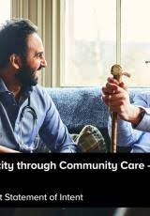
A Case for Change
Improved Outcomes for Population
Health and Social Care System Resilience
‘Integration’
Integrated Community System OR Integrated Community Care System?
Asset not Deficit
Do with not Do For
From Reactive to Preventative and Proactive (Early Intervention)
…Effective Population Health Management

Slide 5
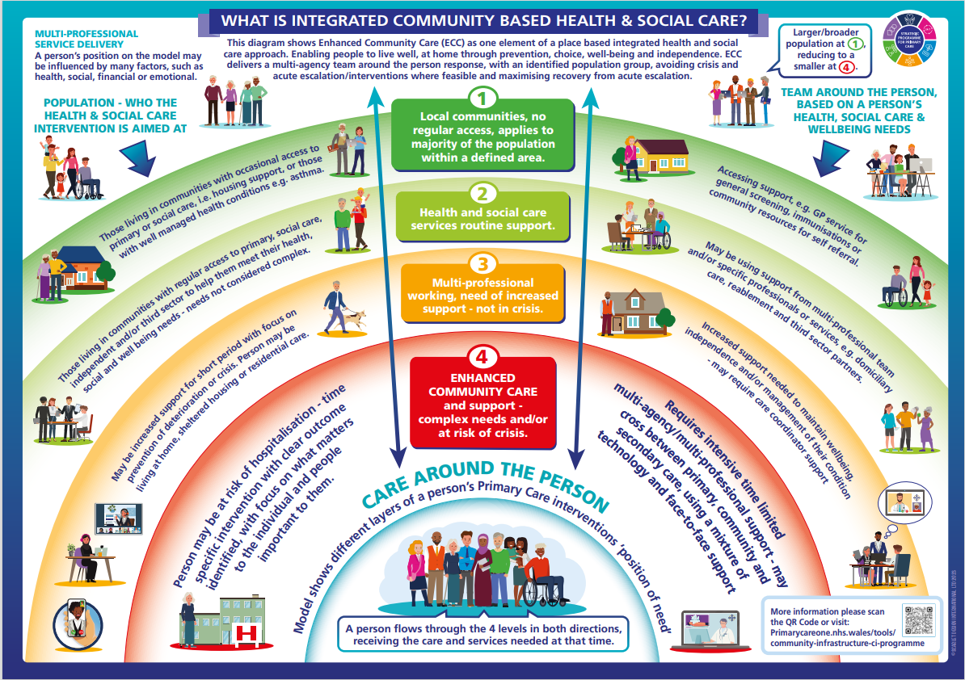
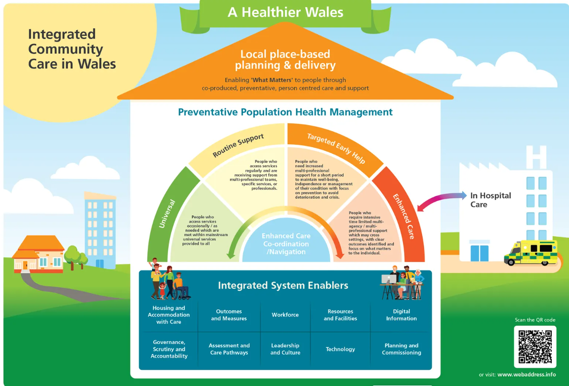
The emerging national model

Slide 6
Why Bother?

Slide 7
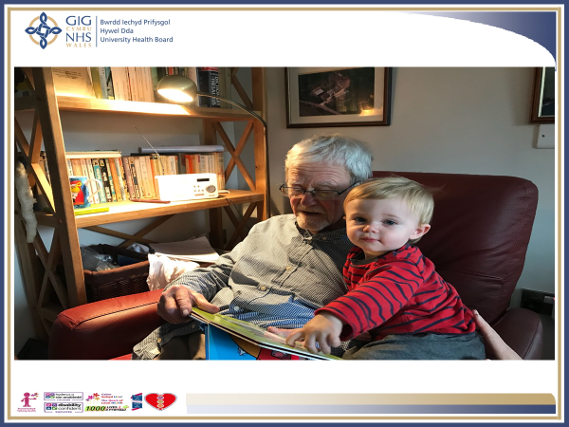
Notes:
Ageing complex population – system too reactive, poor outcomes and demand on health and social care that could be avoided through prevention / proactive care
While today focuses on >75s imperative that we also stress importance of population health management for early years / children with complex needs / they are next generation…. our integrated system and our approach equally applies to this population

Slide 8
What problem are we trying to solve?

Slide 9
Mid-Year Population Estimates: 2011 to 2021 v 2021 to 2023 (Core Cities)
Between mid-2011 and mid-2021, Cardiff’s population is estimated to have increased by 4.2% (around 14k people), one of the slowest growth rates across the core cities in England & Wales.
In contrast, its population has increased by 6.6% (around 24k people) in just two years since mid-2021, comfortably the fastest growth rate across the core cities and second only to the City of London across the whole of England & Wales.
Source: Mid-Year Estimates, ONS
Notes:
Cardiff Data – bleak picture…

Slide 10


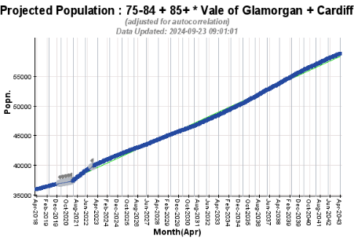
Case for change: future demand
The over-75 population is expected to rise substantially over the next two decades
In 3 years: an anticipated additional 2,300 individuals aged over 75
In 10 years: an extra 8,500 individuals aged over 75

Slide 11
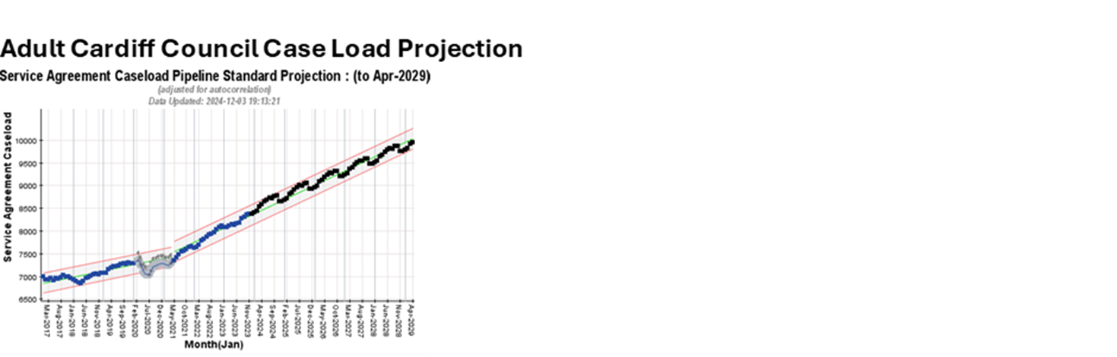
The future if we do nothing
By 27/28:
11-15% increase in UEC demand
2,300 additional acute UEC presentations each month
27,000 urgent care attendances per year
144 to 216 extra hospital beds to handle the demand, specifically for the high need patient group
79,000 extra bed days from the high-risk adult cohort
a 9% increase in adult social care caseloads by March 2028
equivalent to an additional 873 patients
Outpacing population growth
Notes:
.

Slide 12
Integrated Community System Approach for Adults with Complex Needs Carmarthenshire
Case Study

Slide 13
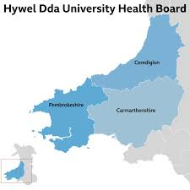
Carmarthenshire
Population 180, 000
Population Needs Assessment
24% > 65s
Rural and Post Industrial (Top 1% Most Deprived Areas in Wales)
Frailty and Complexity
Section 33 Agreement since 2009 – MOU for Adults living with Phys. Disabilities / Sensory Impairment and Older People
Integrated Management Structure
Compact with the Population – What Matters
Help to Help Yourself
Help When you Need It
Ongoing Help When you Need It

Slide 14
Population Outcome?
Well and Independent in their own Home (What Matters)
Population Outcome Indicator - Independence
Proxy Measures of Independence?
Home not Hospital and Residential / Nursing Care
Commissioned Care per 100k population
System Outcomes…
Healthy Days at Home

Slide 15
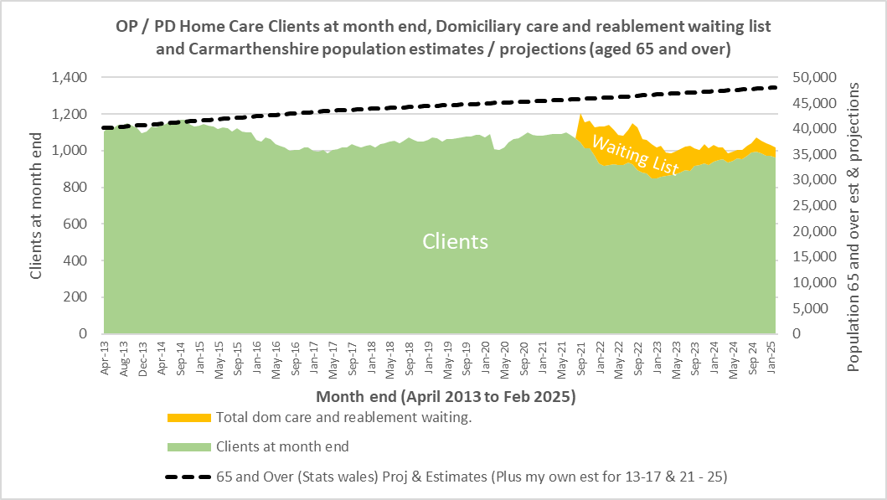
CV-19
ICF/ Integrated CRT’s
Delta Wellbeing Established & Delta Connect Model (RIF)
Fully Integrated IAA/MDT/Delta Connect

Slide 16
Is it worth it?
NHS £5.14 million from reduced hospital bed days
Social Care £2.49 million through prevention of increased care hours on discharge
WAST £611,610 worth of reductions in ambulance conveyance and emergency response costs
ROI of 467% unlocking non-cashable gains by optimising finite health and care resources

Slide 17
The approach in Cardiff and Vale
Case Study

Slide 18


Our journey
RPB Joint Area Plan 23-28 commitment:
@home programme - delivery of an Integrated Community Care System
including key enablers: an integrated workforce, integrated care records and Business Intelligence
Alignment of the ambitions of
Six (actually 2!) Goals for Urgent and Emergency Care
Strategic Programme for Primary Care – Accelerated Cluster Development
Regional Integration Fund – new models of care
C&VUHB commitment…to develop into an Integrated Community Care System
To prevent avoidable harm
To mitigate growth in demand
Right thing to do for our population
Building our confidence
Adopting the ‘rainbow’
SW Cluster model success
Safe@home success

Slide 19


@home: building an integrated community care system
Community assets
Proactive joined up care
CRT/VCRS
Step-down services
Crisis response & admission avoidance
Community beds
Integrated Discharge
Urgent treatment in the community
Connected Community Care
Enhanced Community Care
Reducing time in hospital
Cross-cutting services and functions
Vols and 3rd sector
Housing and support
Information, Advice and Assistance
Tec-enabled care
Reablement and therapy
Care and support
Community nursing
End of Life care

Slide 20
Unlocking delivery: ICCS Phase 1
4 workstreams
Urgent Care Centre delivery
Community hospitals care model
Crisis response
Connected communities
Governance
RPB oversight
Six Goals for U&EC Delivery Board
6 monthly summit
Clear deliverables
Transfer of Community Hospitals and Community Beds – October 2025
Develop an Urgent Treatment Centre (UTC)
Develop a Single Point of Access (SPOA) which aligns to existing SPoAs
Delayering of existing services with similar functions
Refine the benefits realisation and quantify ROI
Consider options to release resources to support the first phase of the ICCS model
Strengthen the partner leadership in the clusters to develop the Connected Community Care approach
Describe support required from the partner Execs to be able to progress delivery

Slide 21

We're not in Kansas anymore Toto...
Quality and experience of care needs to be better
Rising demand and cost needs to be addressed
Our system needs to be better attuned to people living with frailty
Balanced delivery model that embraces prevention in a very real way
Let's go over the rainbow...

Slide 22
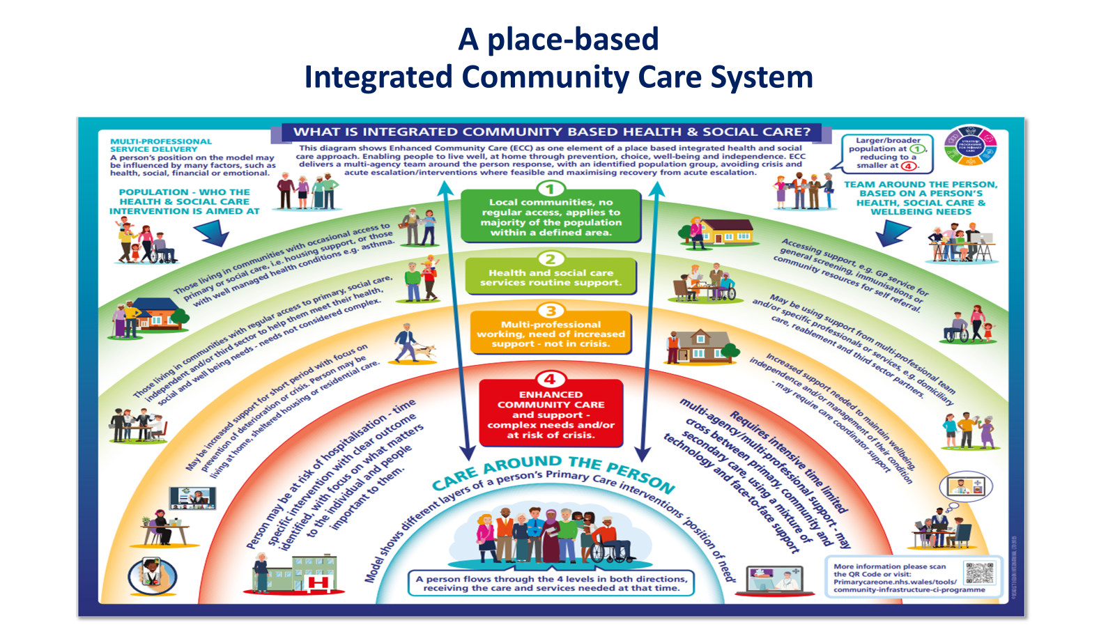
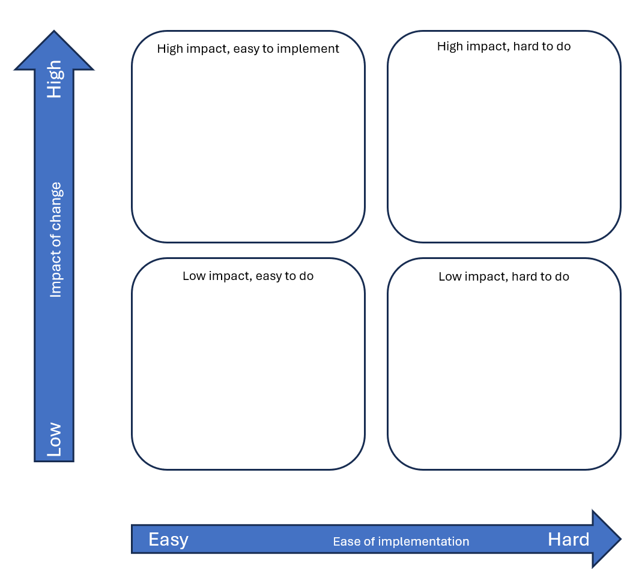

Your turn
4 groups:
each group to considering
1 part of the rainbow
What can we do now?
What will help?
What will hinder?

Slide 23
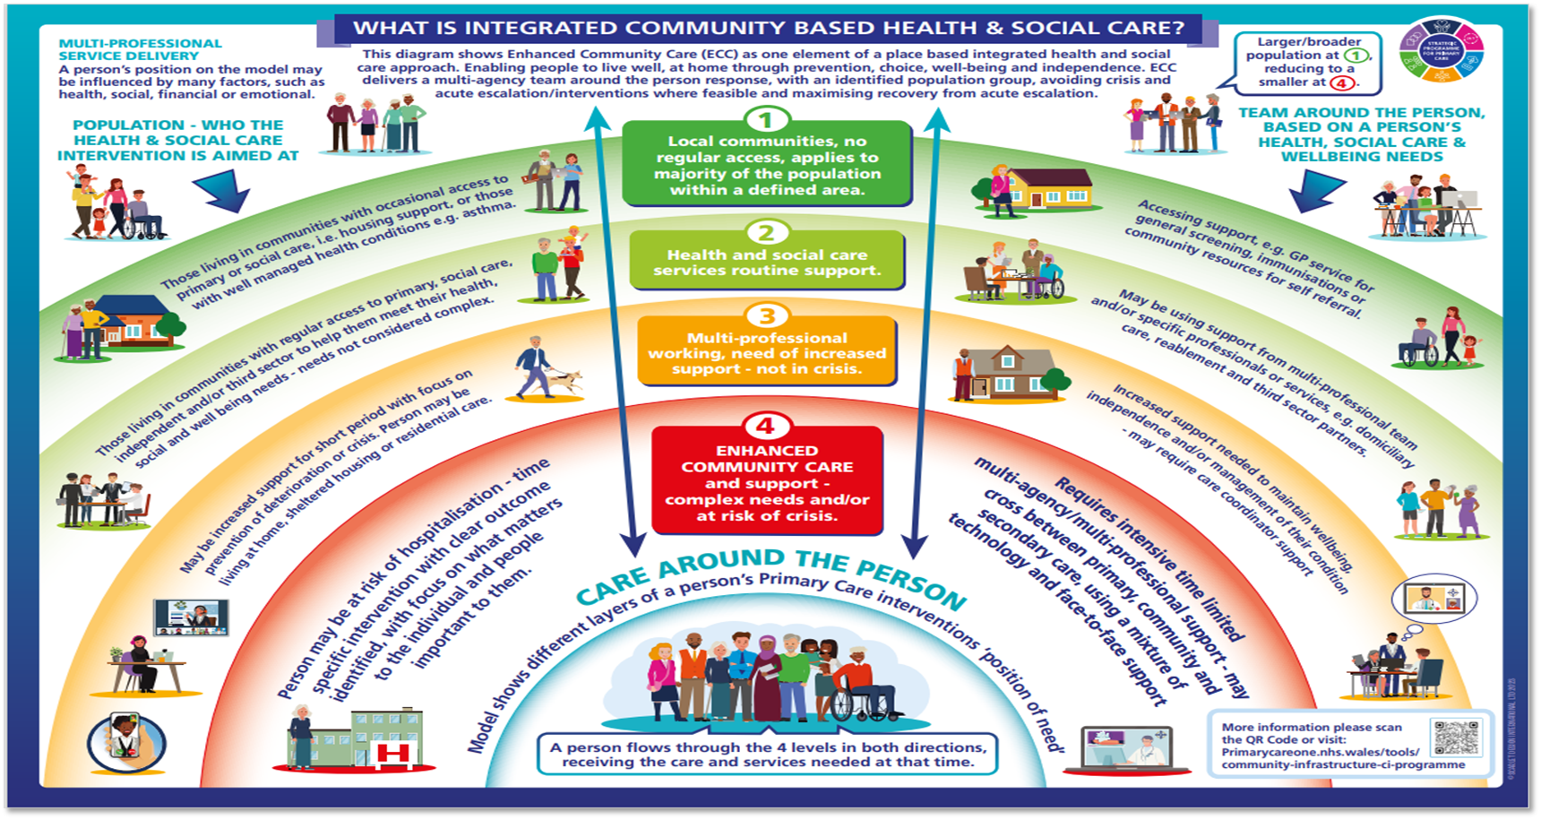
Low Impact of change High
High impact, easy to implement
High impact, hard to do
Local communities supporting health and wellbeing
Low impact, easy to do
Low impact, hard to do
Easy Ease of implementation Hard

Slide 24
Low Impact of change High
High impact, easy to implement
High impact, hard to do
Health and social care services routine support
Low impact, easy to do
Low impact, hard to do
Easy Ease of implementation Hard

Slide 25
Low Impact of change High
High impact, easy to implement
High impact, hard to do
Multi-professional working, need of increased support, not in crisis
Low impact, easy to do
Low impact, hard to do
Easy Ease of implementation Hard

Slide 26
Low Impact of change High
High impact, easy to implement
High impact, hard to do
Enhanced community care – complex needs and/or at risk of crisis
Low impact, easy to do
Low impact, hard to do
Easy Ease of implementation Hard

Slide 27
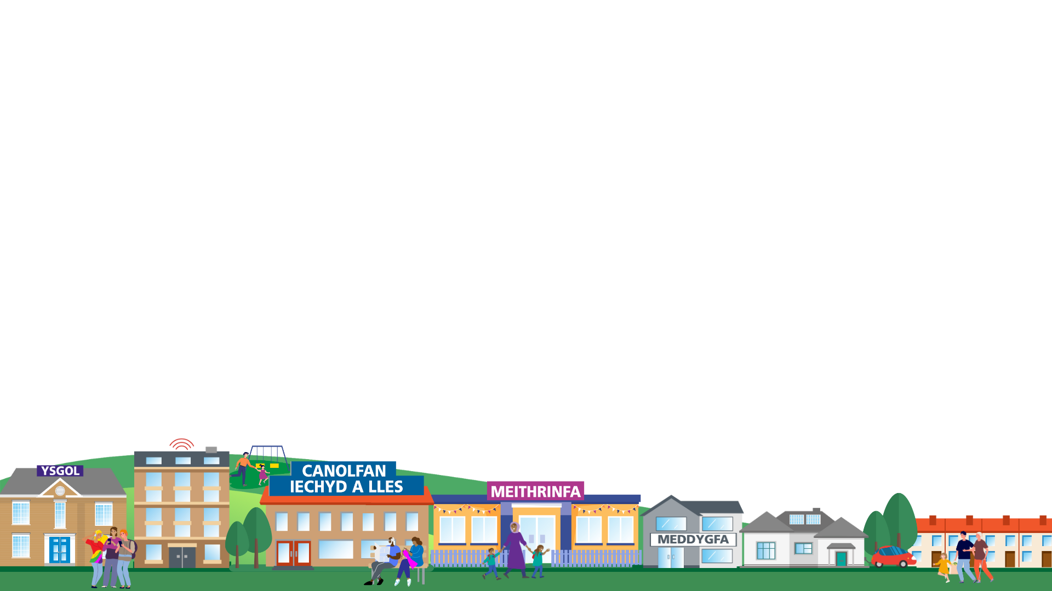

What’s Next?
Market Space is now open:
First Floor: Starting Well, Ageing Well and Enablers
Marble Hall: Living Well and Capital
Lunch served in Foyer and also on the first floor corridor.
Entertainment by Welsh National Opera
2.30pm: Q&A and Awards in the Marble Hall

